Slide 1
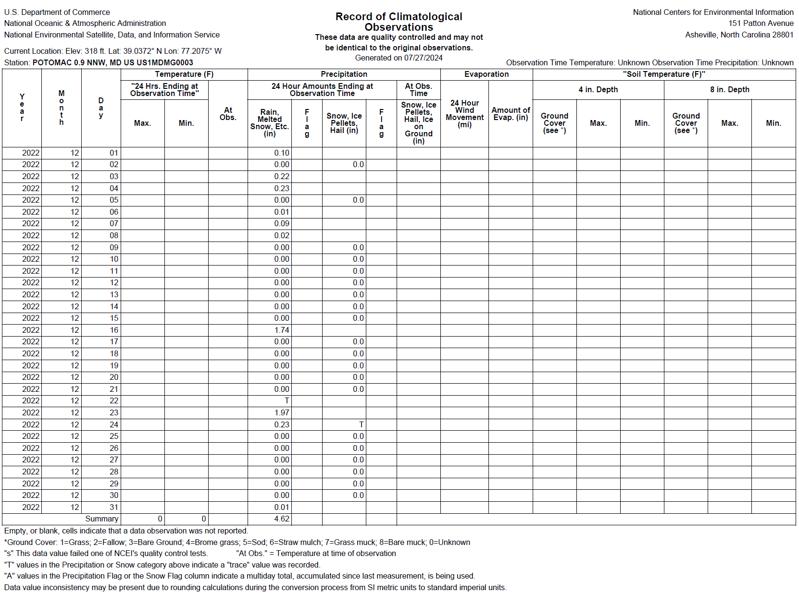
Rain the day before
DPS Visit

Slide 2
Rain in 3 out of 5 days prior to DPS

Slide 3
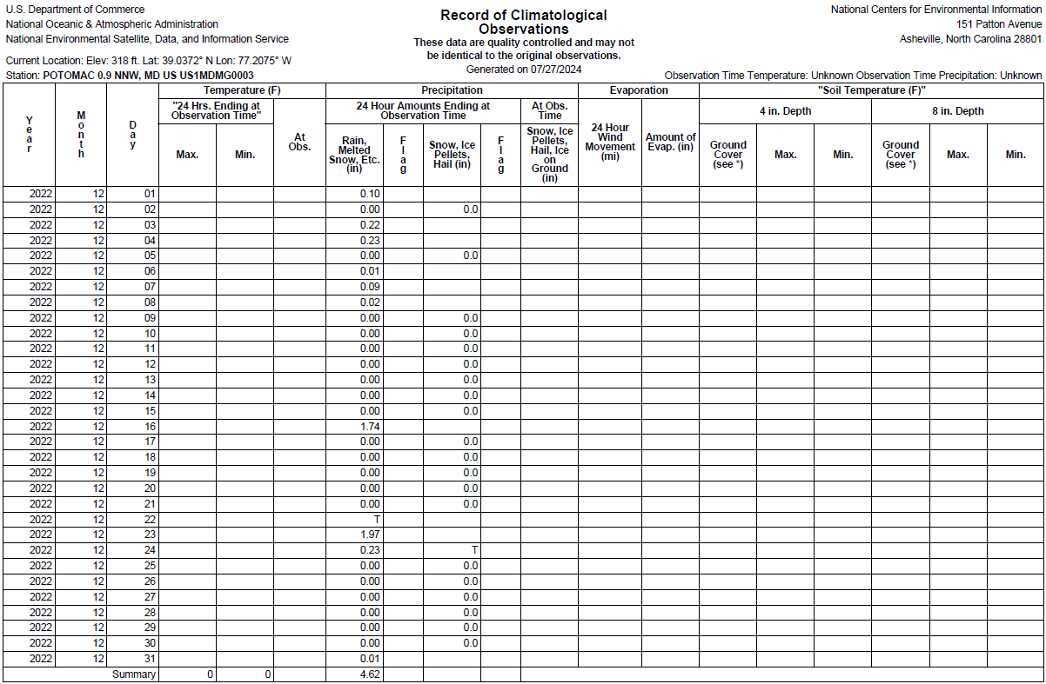
Notes:
It had rained EXTENSIVELY on 23rd and 24th. Yet the channel appears dry on the 27th.

Slide 4
Site Condition on May 2, 2024 after Rain on May 1
Notes:
Applicant recorded the site condition a day after it rained on May 1.
- This is a just few days after Staff’s visit. Channel was completely dry even AFTER rain on the prior day.

Slide 5
9400 Persimmon Tree
May 2, 2024 @ 7:30PM
July 28, 2024 @ 7:37PM
Notes:
That same day on the afternoon, applicant observed flow through the pipe. Upon investigation, it was found flow was originating from the confronting neighbor at 9400 Persimmon Tree road.
Irrigation flow was observed from that same neighbor again on July 28.

Slide 6
9819 Newhall Road
July 28, 2024 @ 11:35AM
Aug 7, 2024 @ 10:39AM
Notes:
- Applicant has also recorded flow through the pipe from the other confronting neighbor at 9819 Newhall road on 2 occasions.

